Slide 1
Outline
1 Course Information
2 The History of Programming Languages and Compilers
3 The Structure of a Compiler
4 Language Process
1
Notes:
1

Slide 2
1-3 The Structure of a Compiler
Section 1 Introduction
Principle of Compiler, 2021
Ying Weiqin
School of Software Engineering

Slide 3
How does a compiler work?
Example A
Structure
Example B
Working Process and Division

Slide 4
4Ω
3Ω
6Ω
6V

Slide 5
4Ω
3Ω
6Ω
6V

Slide 6
4Ω
3Ω
6Ω
6V

Slide 7
4Ω
3Ω
6Ω
6V

Slide 8
4Ω
3Ω
6Ω
6V

Slide 9
4Ω
3Ω
6Ω
6V

Slide 10
4Ω
3Ω
6Ω
6V

Slide 11
4Ω
3Ω
6Ω
6V
1
+
=2 Ω
1
3Ω
1
6 Ω

Slide 12
4Ω
2Ω
6V
1
+
=2 Ω
1
3 Ω
1
6 Ω

Slide 13
4Ω
2Ω
6V

Slide 14
4Ω
2Ω
6V
4 Ω + 2 Ω =6 Ω

Slide 15
6Ω
6V
4 Ω + 2 Ω =6 Ω

Slide 16
6Ω
6V

Slide 17
6Ω
6V
6V

Slide 18
6Ω
6V
Total Cost: $4.75
6V

Slide 19
6Ω
1.5V
1.5V
1.5V
1.5V

Slide 20
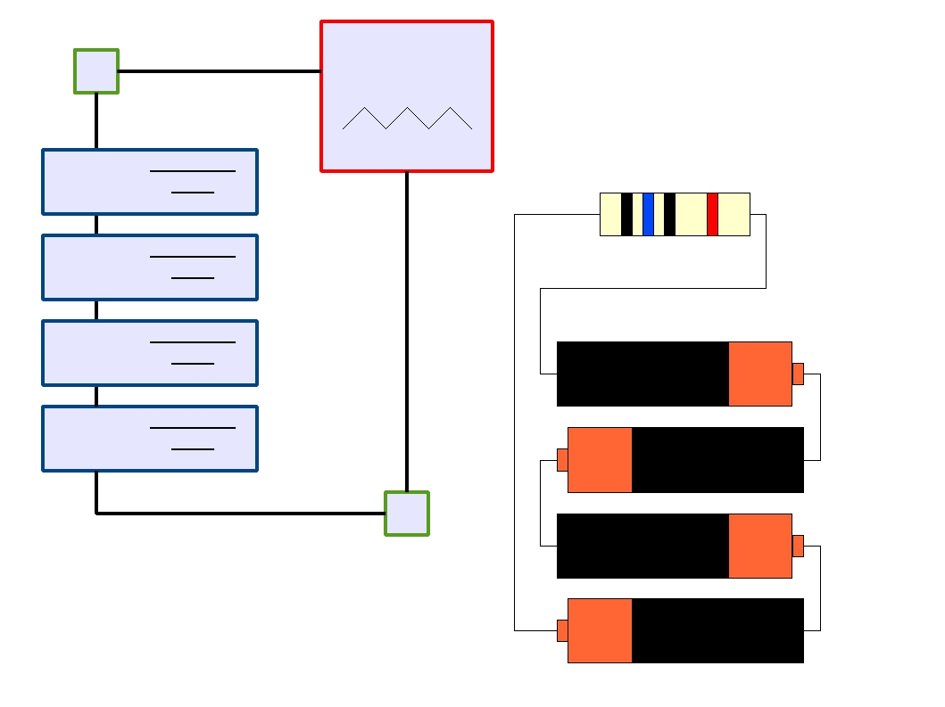
6Ω
1.5V
1.5V
1.5V
1.5V
AAA
AAA
AAA
AAA

Slide 21

6Ω
1.5V
1.5V
1.5V
1.5V
Total Cost: $1.00
AAA
AAA
AAA
AAA

Slide 22
How does a compiler work?
Example A
Structure
Example B
Working Process and Division

Slide 23
From Description to Implementation
Lexical analysis (Scanning): Identify logical pieces of the description.
Syntax analysis (Parsing): Identify how those pieces relate to each other.
Semantic analysis: Identify the meaning of the overall structure.
IR Generation: Design one possible structure.
IR Optimization: Simplify the intended structure.
Generation: Fabricate the structure.
Optimization: Improve the resulting structure.

Slide 24
The Structure of a Modern Compiler
Source
Code
Lexical Analysis
Syntax Analysis
Semantic Analysis
IR Generation
IR Optimization
Code Generation
The first 3, at least, can be understood by analogy to how humans comprehend language.
Optimization
Machine
Code

Slide 25
The Structure of a Modern Compiler
Source
Code
Lexical Analysis
Syntax Analysis
Semantic Analysis
IR Generation
IR Optimization
Code Generation
Front End
Back End
Optimization
Machine
Code

Slide 26
How does a compiler work?
Example A
Structure
Example B
Working Process and Division

Slide 27
while (y < z) {
int x = a + b;
y += x;
}
Lexical Analysis
Syntax Analysis
Semantic Analysis
IR Generation
IR Optimization
Code Generation
Optimization

Slide 28
while (y < z) {
int x = a + b;
y += x;
}
T_While
T_LeftParen
Lexical Analysis
T_Identifier
T_Less
T_Identifier
T_RightParen
T_OpenBrace
T_Int
T_Identifier
T_Assign
T_Identifier
T_Plus
T_Identifier
T_Semicolon
T_Identifier
T_PlusAssign
T_Identifier
T_Semicolon
T_CloseBrace
y
z
x
a
b
y
x
Syntax Analysis
Semantic Analysis
IR Generation
Tokens
IR Optimization
Code Generation
Optimization

Slide 29
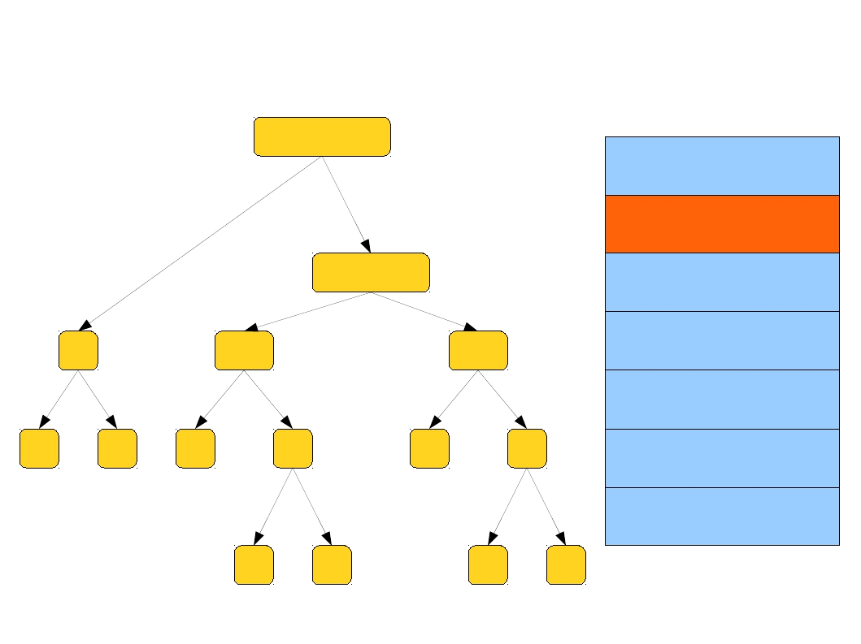
while (y < z) {
int x = a + b;
y += x;
}
Syntax Tree
While
Lexical Analysis
Syntax Analysis
Sequence
Semantic Analysis
<
=
=
IR Generation
IR Optimization
y
z
x
+
y
+
Code Generation
Optimization
a
b
y
x

Slide 30
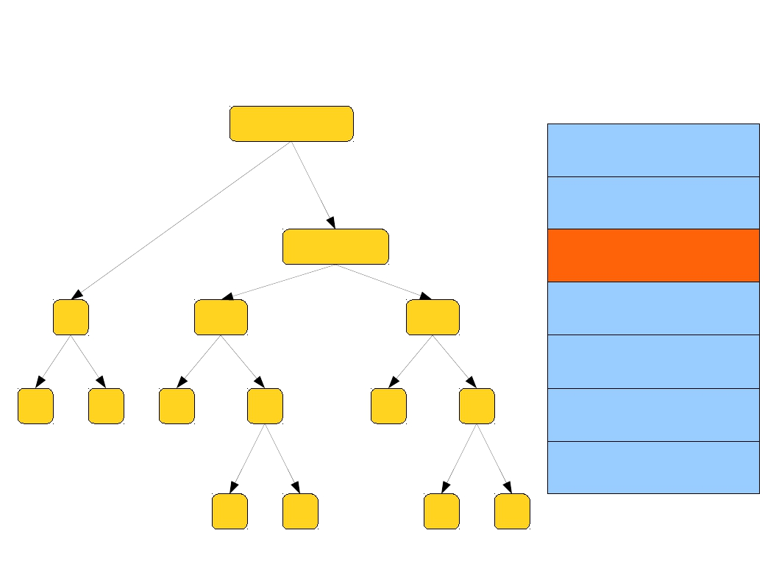
while (y < z) {
int x = a + b;
y += x;
}
Annotated Syntax Tree
While
void
Lexical Analysis
Syntax Analysis
Sequence
void
Semantic Analysis
<
=
=
int
IR Generation
bool
int
IR Optimization
y
int
z
int
x
int
+ int
y
int
+
int
Code Generation
Optimization
a
int
b
int
y
int
x
int

Slide 31
while (y < z) {
int x = a + b;
y += x;
}
Lexical Analysis
Loop: x = a + b
y = x + y
_t1 = y < z
if _t1 goto Loop
Syntax Analysis
Semantic Analysis
IR Generation
IR Optimization
Intermediate code
Code Generation
Optimization

Slide 32
while (y < z) {
int x = a + b;
y += x;
}
x = a + b
Loop: y = x + y
_t1 = y < z
if _t1 goto Loop
Lexical Analysis
Syntax Analysis
Semantic Analysis
IR Generation
IR Optimization
Code Generation
Optimization

Slide 33
while (y < z) {
int x = a + b;
y += x;
}
add
Loop: add
slt
beq
$1,
$4,
$6,
$6,
$2, $3
$1, $4
$4, $5
loop
Lexical Analysis
Syntax Analysis
Semantic Analysis
IR Generation
IR Optimization
Target code
Code Generation
Optimization

Slide 34
while (y < z) {
int x = a + b;
y += x;
}
add $1, $2, $3
Loop: add $4, $1, $4
blt $4, $5, loop
Lexical Analysis
Syntax Analysis
Semantic Analysis
IR Generation
IR Optimization
Code Generation
Optimization

Slide 35
How does a compiler work?
Example A
Structure
Example B
Working Process and Division

Slide 36
Source code
Scanner
Tokens
Parser
Syntax Tree
Literal table
Semantic analyzer
Annotated Tree
Symbol table
Intermediate code generator
Intermediate code
Error handler
Intermediate code optimizer
Intermediate code
Auxiliary components that interact with some phases
Code generator
Target code
Target code optimizer
Target code

